Slide 1
Kyndryl AppDynamics Support
Presenters:
Damian Waid
Service Delivery Manager
Staci Steger
Team Lead/Project Manager
Sayed Rahman
AppD Engineer
Raj Patel
AppD SME
November 2024
Notes:
Audience:
When to use:

Slide 2
Agenda
01
02
03
04
05
06
Intros and Agenda
AppDynamics Application Onboarding
License Types
AppDynamics Steady State Support
AppDynamics High Availability Controller
AppDynamics Demo

Slide 3
AppDynamics Application Onboarding
Planning (3-5 days)
QA Implementation (5-10 days)
Finalize QA (3-5 days)
Prod Migration (5-10 days)
Roadshow Meeting
Phase implementation and customer interaction times are subject to change based on user requirements:
Number of servers
# of customer BTs
# of customer health rules
# of custom health rules
# of created dashboards
Complexity of environment
Additional Configuration
Complete Application Questionnaire
Install/Configure Agents
Controller Access
BT Discovery
MVP & Customized Dashboards
Configure Tiers & Nodes
Configure & Test Health Rules
During this activity, Kyndryl AppD support will replication all custom configurations, settings & Dashboards from QA into Prod. This can be done manually or with use of a config exporter tool.
Configure/Test Alerts
During this activity we will replicate all custom configurations, settings, and dashboards from QA into PROD. This can be done manually or with the use of a config exporter tool.
Along the bottom are estimated times per phase that will require efforts from the application team
Sign-Off
Install Prod Agents
Replication QA Environment
Test, Validation, Sign-Off
3-5 Hours for Planning
1-4 hours for Reviews & Touchpoints
1-10 Hours for Troubleshooting & Configuration
1-2 Hours for Reviews & Touchpoints

Slide 4
License Types
AppDynamics offers a diverse licensing model to allow application teams to customize the degree of Application Performance Monitoring that will best suit their needs.
AppDynamics License Types
Application Performance Monitoring (APM)
End-User Monitoring (EUM)
Application Performance Monitoring (APM) provides end-to-end visibility on the application performance. AppD works with popular programming languages such as Java, .NET, Node.js, PHP, Python, C/C++, and more.
•Troubleshoot problems such as slow response times and application errors.
•Automatically discover application topology
•View end to end business transactions performance
•Dynamic baselines alert you in the context of business transactions.
End-User Monitoring (EUM) provides end-to-end visibility on the performance of web and mobile applications. EUM provides metrics on application performance and user activity, such as:
•How server performance impacts your web and mobile performance
•How third-party APIs impact your web and mobile performance
•Where your heaviest loads originate
•How your users connect to and navigate your application
Database Visibility
Infrastructure Visibility
Database Visibility gives you end-to-end visibility on the performance of your database. Database Visibility provides metrics on database activity, such as:
•SQL statements or stored procedures system resource consumption
•Statistics on procedures, SQL statements, and SQL query plans
•How much time is spent fetching, sorting, or waiting on a lock
•Activity from the previous day, week, or month
Infrastructure Visibility gives you end-to-end visibility on the performance of the hardware running your applications. Infrastructure Visibility provides metrics such as:
•CPU busy/idle times, disk and partition reads/writes, and network interface utilization (Standalone Machine Agents)
•Disk/CPU/memory utilization, process, and machine availability (Server Visibility, additional license required)
Notes:
Share high availability

Slide 5






Kyndryl’s AppDynamics Steady State Support
Environment Snapshot
Total Patching Management
QA Dashboards | 859
Prod Dashboards | 693
Installed Agents | 670
Applications Supported | 58
US and Canada environments supported across (4) controllers
Ensure that following activity is complete on the below basis:
Infrastructure Patching | Semi-Annual
AppD Agent Patching | Semi-Annual
SSL Certificate Renewals | Annual
Service Requests
Changes
Incidents
140 Service Requests These service requests included onboarding of new applications, additional/adjustments of health rules, ticket integration, user access, data retention, security scans and remediations, agent installs, dashboard creation, etc.
65 Changes These changes include agent installs, agent upgrades, infrastructure upgrades, and certificate updates.
89 Incidents These incidents include machine availability, URL issues impacting the AppD infrastructure, user access, etc.

Slide 6
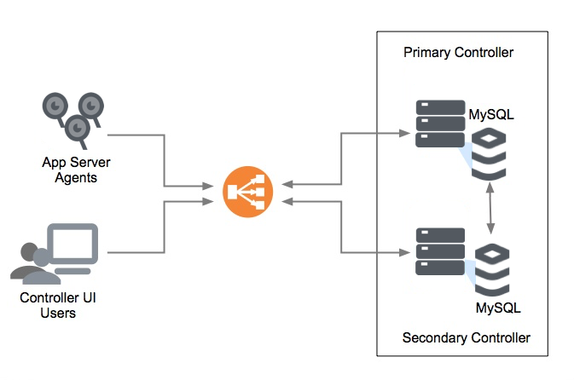
Kyndryl’s AppDynamics Overview of High Availability Controller
Deploying Controllers in a High Availability (HA) configuration ensures minimal downtime during server failures or maintenance. The setup features two Controllers, each with its own MySQL database, using Master-Master replication to maintain synchronized data. This configuration supports seamless failover, optimized maintenance, and resource-intensive tasks like data backup or long-running queries on the secondary Controller without impacting live operations.
Key highlights:
​
Resilience: Ensures system availability and reduced disruption. ​
Data Sync: Primary and secondary Controllers maintain updated replicas. ​
Load Balancing: Agents connect via a proxy load balancer for redundancy.
Recommended Setup: Equivalent versions and resources in the same data center, with a dedicated high-capacity link for replication.

Slide 7
Thank You
November 2024

